Slide 1
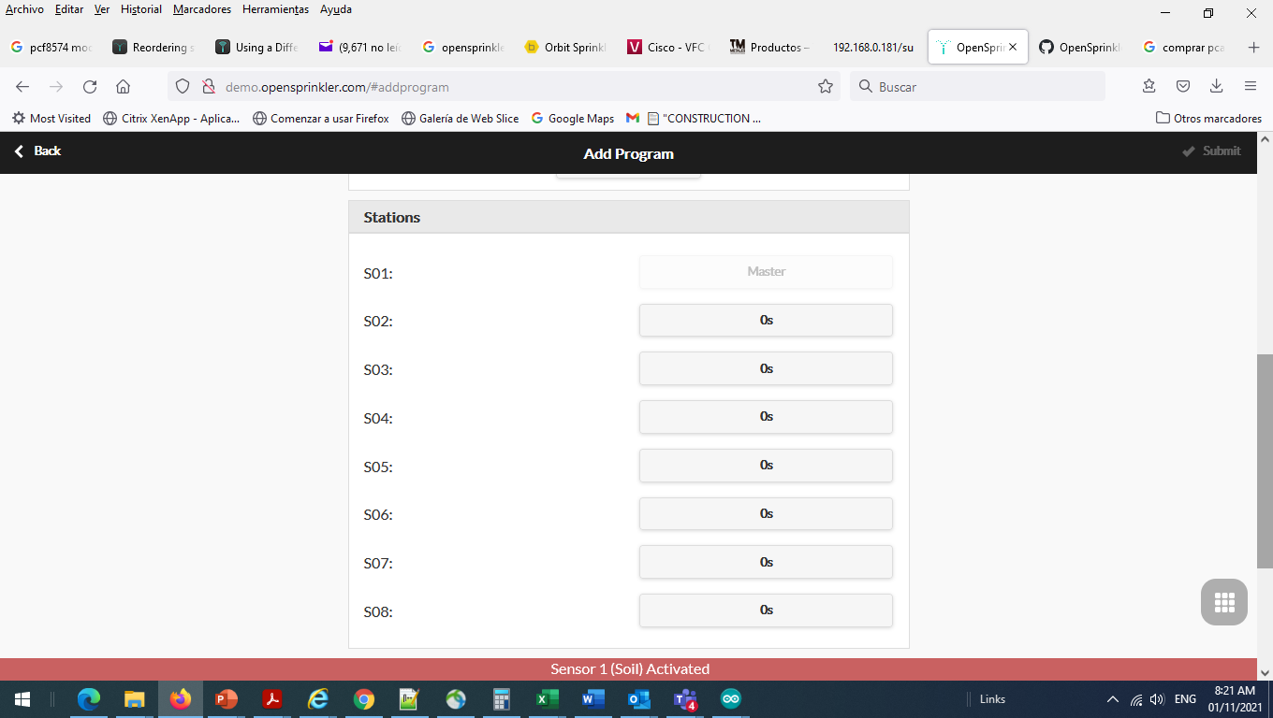
Current Web GUI

Slide 2
Proposed Web GUI with station order
S02:
Drop down menu
to select any station
S03:
S04:
S05:
S06:
S07:
S08:

